Slide 1
Recent Developments in the Fight Against Financial Crime
Justin Mendelsohn
Deputy Head of AML and Sanctions, Brown Brothers Harriman & Co.

Slide 2
Agenda
The Potential of Blockchain in the Fight Against Financial Crime
Blockchain Basics
Potential Application in Trade Finance
Anti-Corruption
Know Your Customer
II. Regulatory Update: The FinCEN Customer Due Diligence Rule
Case Study: A Recent Major Money Laundering Scheme Exposed
Recent Enforcement Actions Against Financial Institutions

Slide 3
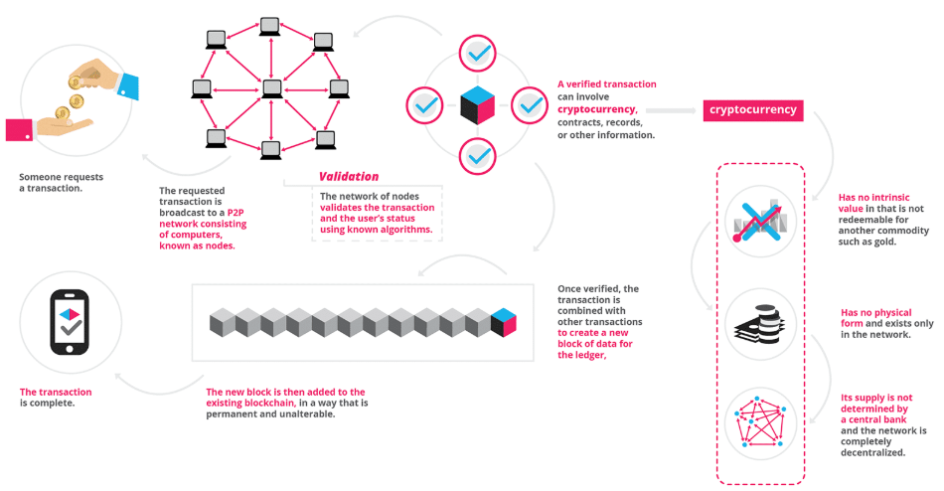
What is the Blockchain?
The blockchain is an incorruptible digital ledger of economic transactions that can be programmed to record virtually anything of value.
At it essence: an encrypted, decentralized database that is overwhelmingly secure.

Slide 4
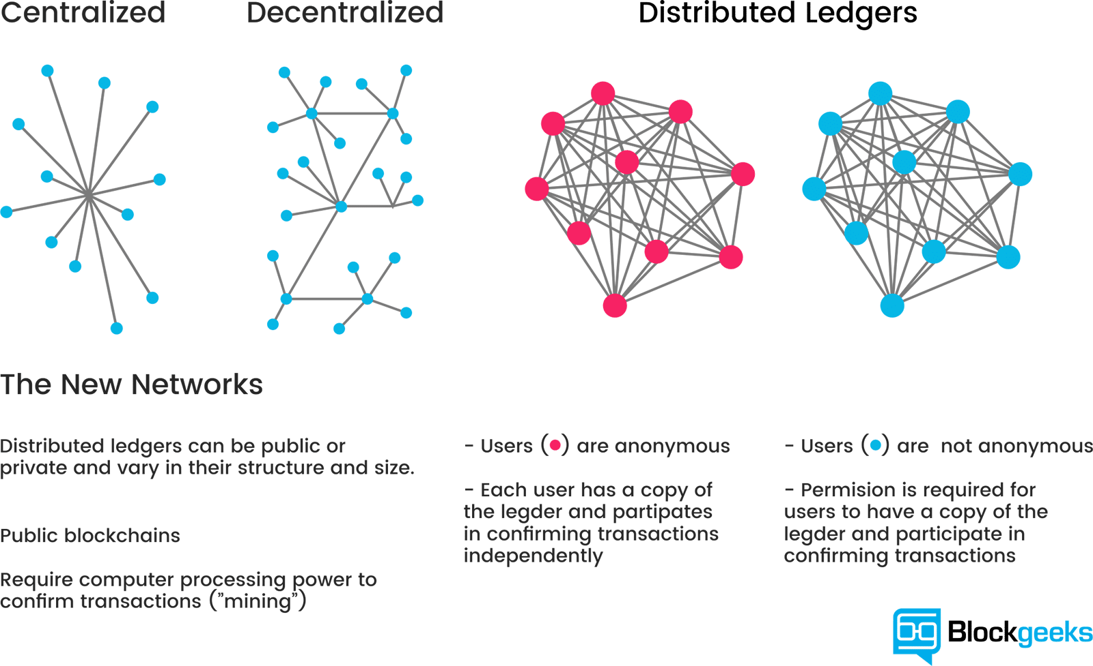
The Power of Distributed Ledgers

Slide 5
The Promise of Blockchain
Features of Blockchain that make it a potentially potent weapon in the fight against financial crime:
Data Security
Incorruptibility
Each link in the chain contains a cryptographic hash, a timestamp and the relevant transactional data. All transactions are recorded on the network and all transactions are continuously validated by all participants (nodes) on the network.
The more nodes, the more secure as hackers would have to hack at least half of all nodes instantaneously to corrupt the blockchain.
Immutability of Records
Once a block is written to a blockchain it generally cannot change.
Transparency
Access to the Data
All transactions are reconciled on a continuous basis by all participants (nodes) on the network – meaning the data is transparent to all nodes in the chain.
The data is encrypted so only the persons involved in the transaction can access the digital assets.
Blockchains can be made private and distributed to certain participants or open to the public.

Slide 6
Application of Blockchain Technology to AML and Anti-Corruption
Two areas ripe for disruption by Blockchain technology in the fight against financial crime are Trade Finance and Government Corruption
Trade Finance
The financing of international trade by importers, exporters, banks and insurance companies. Generally, refer to letters of credit, documentary collections and guarantees to facilitate the transfer of goods and payment of monies owed.
Susceptible to Fraud and Trade Based Money Laundering (“TBML”)
TBML is the process by which criminals use a trade to disguise criminal proceeds
Common typologies: falsifying documents, misrepresenting financial transactions, moving illicit goods under or over-invoicing the value of goods;
Other “red flags” authorities and compliance officers are trained to observe: payments to vendors by unrelated third parties, carousel transactions (repeated importation and exportation of the same high-value commodity); and unusual shipping routes or transshipment points
The vulnerability of the Trade Finance sector arises by the archaic processes that still dominate the industry: namely, the reliance on paper-based contracts, invoices and bills of lading.
In addition, parties are often scattered all over the world, maintaining different controls, platforms and multiple levels of attempted verifications prior to the disbursement of funds

Slide 7
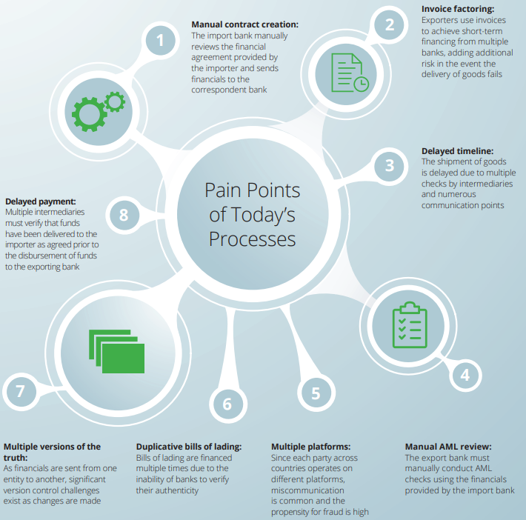
An Illustration: Trade Finance
This graphic demonstrates some of the risk and choke points of a typical trade finance transaction.
Manual, paper-based processes make the lifecycle of a transaction ripe for fraud, money laundering and inadvertent errors.
It is also a lengthy process with various reasons for delay.

Slide 8
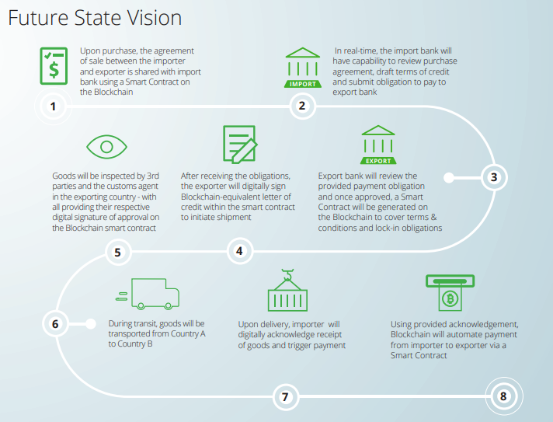
An Illustration: Trade Finance
This illustration of a Trade Finance transaction conducted via blockchain shows the potential for streamlining – and securing – the process.
Allows for real-time review of financial documents by all parties involved in the transaction
Invoices and terms are transparent to all involved and allows for a verified review by compliance (or law enforcement) departments
Disintermediation: no need for a correspondent back as importer and exporter bank are transmitting directly to one another.
In May 2018, HSBC and ING completed the first Letter of Credit using Blockchain, with HSBC issuing the LoC on behalf of Cargill to ING relating to the shipment of soybeans from Argentina to Malaysia. The exchange was performed in 24 hours, compared to the 5-10 usual time frame.

Slide 9
Application of Blockchain Technology to AML and Anti-Corruption
While business needs are driving innovation in Trade Finance, anti-corruption and governance experts are envisioning the potential of Blockchain to curb government corruption.
Anti-Corruption Efforts
One of the most insidious effects of cronyism and graft: people lose confidence the public institutions are working for the public.
Corruption is one of the most significant causes of extremism and violence in the world.
The Potential of Blockchain
Verification of Identity (discussed in the next slide)
Registering Assets
Property registry and land titling, especially in countries where land is not generally registered
Beneficial owner registries
Tracking Transactions
Procurement Process: Each step of the chain can be monitored, tracked and subject to audit.

Slide 10
Application of Blockchain Technology to AML and Anti-Corruption
Verification of Identity and Know-Your-Customer
The decentralized, immutable nature of a blockchain makes it a promising tool to verify an individual’s or company’s identity helping fight identity theft, bribery and fraud.
Provides a digital certification of identity information far more reliable than any notary or human certifier.
Know-Your-Customer regulations require regulated financial institutions to verify the identity of their customers
Rules require varying levels of customer due diligence, beneficial owner identification and other requirements to ensure the financial institutions understand the nature, business and source of wealth of their customers.
KYC compliance is a significant cost with some major financial institutions spending up to $500 million annually on KYC and customer due diligence.
In fact, 10% of the world’s top financial institutions spend at least $100 million on the process. 19% increase in 2017 compared to 2016.
And even those firms with strong, fully-funded KYC programs have varying levels of success in rooting out bad actors. This makes the promise of Blockchain and a reliable, immutable digital identity an intriguing proposition.
Potential Obstacles
Regulations vary across the world
Section 326 of the PATRIOT Act, 4AMLD, Cayman Islands
Regulatory uncertainty
Investment in back-office functions
Privacy regulations (i.e., GDPR)
Is it just SharePoint or Google Docs 2.0?

Slide 11
Application of Blockchain Technology to AML and Anti-Corruption
Government Accountability
Using that technology may help curb government waste – even if no corruption is uncovered.
The 1st phase of the Second Ave subway cost: $2.5 billion for each mile of track
Similarly situated extension in Paris cost: $450 million per track mile
What if there was a publicly accessible, immutable register that showed every disbursement of that $2.5 billion?
Transparency + Incorruptibility = Increased Accountability
In no means will Blockchain be a panacea for government corruption or waste; but it can be a useful tool to curb both problems.

Slide 12
Regulatory Development: FinCEN CDD Rule Overview
Background
On May 11, 2016, FinCEN published the Customer Due Diligence Requirements for Financial Institutions (the “CDD Rule”), with an Applicability Date of May 11, 2018
The CDD Rule requires covered financial institutions to identify and verify the identity of Beneficial Owner(s) of all Legal Entity Customers (e.g., Corporations, LLCs, LPs, Funds) at the time a new account is opened, subject to certain exclusions and exemptions
Beneficial Ownership information must be certified by an individual at the Legal Entity Customer authorized to open the account
Beneficial Owner(s): Any individual ultimately holding, directly or indirectly, a 25% or more equity interest of the Legal Entity Customer
Designated Controller: A single individual with significant responsibility for managing the Legal Entity Customer (e.g., CEO, CFO, Managing Member, General Partner, President, Vice President, Treasurer)
Impact
Updated Definition and Requirements for Beneficial Ownership
Additional Customer Due Diligence Requirement
Beneficial Ownership Information Obtained at Account Opening

Slide 13
FinCEN CDD Rule Overview
What is Required?
IDENTIFICATION of the following for Beneficial Owner(s) and Controller:
Name
Date of Birth
Address and Country of Residence
Social Security Number for US individuals; Passport number or other government issued identification number for non-US individuals
VERIFICATION of identity of Beneficial Owner(s) and Controller via photo ID (e.g., driver license or passport)
CERTIFICATION of a customer’s beneficial ownership information using BBH’s Beneficial Ownership Certification form
IDENTIFICATION
VERIFICATION
CERTIFICATION

Slide 14
FinCEN CDD Rule Overview
CDD Rule Beneficial Ownership Requirements
Legal Entity Customers
Non- Statutory Trusts
Individuals
Who is in Scope?
The CDD Rule applies to BBH’s Legal Entity Customers, which include corporations, LLCs, or other entities created by the filing of a public document with a Secretary of State or similar office, a general partnership, and any similar entity formed under the laws of a foreign jurisdiction
The Beneficial Ownership Certification form, certifying to information on both the Beneficial Owner AND Controller, as well as verification documentation for these individuals must be obtained for in-scope Legal Entity Customers
Individuals and non-statutory trusts are exempt from the CDD Rule
A statutory trust is a trust created by a filing with a state office (e.g., Delaware Statutory Trusts)
Collective investment schemes established as trusts (i.e., unit trusts) are in scope
Legal Entity Customers
Beneficial Owner
+
Controller
Partially Excluded Customers
Controller
Fully Excluded Customers
Who is Excluded?
FULL EXCLUSION: Certain customer types are not included in the definition of Legal Entity Customer and are fully excluded from the CDD Rule [See next slide]
The Beneficial Ownership Certification form does not need to be obtained from excluded customer types
PARTIAL EXCLUSION: Certain Legal Entity Customers are subject only to Certification of the Controller information and do not need to identify Beneficial Owners [See next slide]
Beneficial Ownership Certification and verification document required for Controller only

Slide 15
FinCEN CDD Rule Overview
Partially Excluded Customer Types
Charities and non-profits
Funds NOT Operated or advised by a US Bank or US SEC registered investment adviser
Customers Excluded from the CDD Rule
Fully Excluded Customer Types
US Banks; Non-US Banks, securities broker-dealers, and futures commission merchants located in an Approved Jurisdiction*
US-based SEC or CFTC registered NBFIs including investment advisers and broker-dealers
US State regulated insurance companies
Public Operating Companies listed on US stock exchanges and their US-based subsidiaries
Governmental entities including central banks, US state and local government entities, governmental institutions
Funds Operated or advised by a US Bank or US SEC registered investment adviser
Open and Closed ended 40’ Act Funds
Partially excluded customer types require the Beneficial Ownership Certification for the Controller only
Funds do not need to provide ownership as such entities often have ownership interests that fluctuate
Charities and nonprofits do not have ownership interests

Slide 16
Major Recent Money Laundering Case: Operation Money Flight
Background
Prior to recent developments, Venezuela had a foreign-exchange system in which the government will exchange Bolivars (VEF) at a fixed rate for US Dollars well under the true economic rate
In 2014, the Venezuelan government fixed-exchange rate from VEF to USD was approx. 6:1
The true economic exchange rate from VEF to USD was approx. 60:1
An individual could exchange USD 10 million for VEF 600 million at the true economic rate, but with access to the government fixed rate, the individual could convert the same VEF 600 million into USD 100 million. Essentially, in two transactions, that person bought USD 100 million for USD 10 million
Petroleos de Venezuela, SA (“PDVSA”), Venezuela’s state-owned oil company, served as the primary source of income and foreign currency (namely, USD and EUR) as well as the source used to fund corrupt foreign exchange embezzlement schemes
On July 23, 2018, the United States Attorney District Court for the Southern District of Florida unsealed a Criminal Complaint for conspiracy to commit money laundering and racketeering for a wide ranging scheme to launder illicit funds embezzled from PDVSA.
The three (3) main vehicles that facilitated money laundering were:
Abuse of the Venezuelan foreign currency exchange system;
Sophisticated false investment schemes; and
Manipulation of legitimate assets/investments (e.g., real estate and government bonds)

Slide 17
Operation Money Flight
Money Laundering Scheme
The source of the PDVSA funds—approx. USD 600 million obtained through bribery and fraud—was PDVSA’s foreign-currency exchange scheme benefitting Eaton Global Services Limited (“Eaton Global”), a Hong Kong shell company, disguised as a “financing” arrangement using the following three (3) fake documents:
A loan contract between PDVSA and Rantor Capital C.A. (“Rantor”), a Venezuelan Shell Company, in which Rantor would loan PDVSA VEF 7.2 billion (December 17, 2014);
An assignment contract between Rantor and Eaton Global, in which Rantor assigned its rights as PDVSA’s creditor under the loan contract to Eaton Global, gave PDVSA the right to cancel the debt within 180 days by paying USD 600 million (December 23, 2014); and
A notice of assignment letter, in which Eaton Global informed PDVSA of the assignment and suggested that PDVSA repay the VEF 7.2 billion loan in the EUR equivalent of USD 600 million. The letter included wire instructions to accounts maintained at a European Financial Institution benefitting Eaton Global (December 23, 2014)
Contracts, both original and later-updated versions, included a complex array of bogus financing and trust documents
This resulted in Eaton Global having the right to pay PDVSA approx. VEF 7.2 billion (worth approx. EUR 35 million) and receive approx. EUR 510 million, of which about EUR 78.8 million was sent to the CS, who was expected to launder the proceeds of the embezzlement and make cash kickback payments to “Venezuelan Official 1”

Slide 18
Operation Money Flight
Money Laundering Scheme
False Investments
An initial fake joint venture contract was replaced with better fake contracts to justify the initial transfers to the CS to avoid scrutiny from compliance departments;
Fraudulent bonds designed to conceal the transfer of laundered funds were purchased;
A new company, Paladium Real Estate Group LLC (“Paladium”), was formed to purchase real estate in Miami to avoid FinCEN reporting requirements for taking title under a company/trust;
The ownership of Paladium was ultimately transferred following the closing; therefore, the transferring of the condo served as the fee for laundering services and going forward, the defendants would utilize a defaulting-bond plan;
A fake fund was set up with minimal KYC requirements at a European Financial Institution to generate payment structures and receive third-party payments;
A legitimate GBP 5 million UK GILT was purchased, then free-delivered to the CS’s account maintained at a European Financial Institution, and then exchanged for a worthless bond so the funds are concealed and ultimately transferred to one of the defendants;
Global Security Advisors (“GSA”), affiliated with Global Strategic Investments, LLC (“GSI”), both of which are legitimate entities based in the United States, operated a fake mutual fund (Global Securities Trade Finance) domiciled in the Cayman Islands, which received laundered funds disguised as subscriptions, custodied at a bank in New Jersey; and
The bank in New Jersey, along with a bank in Puerto Rico, is controlled by one of the defendant’s partners from Uruguay

Slide 19
Operation Money Flight
Money Laundering Scheme
A straw owner (Mario Enrique Bonilla Vallera) was used to conceal money for the stepsons of Venezuelan Official 2 (Nicholas Maduro)
Supporting these false-investment laundering schemes were unnamed complicit money managers, brokerage firms, banks, and real estate investment firms, operating as a network of professional money launderers

Slide 20
Major Recent AML Enforcement Actions
New York State Department of Financial Services
Mashreqbank, PSC (October 2018) – Dubai-based Mashreqbank and its New York branch agreed to enter into a Consent Order, appoint an independent monitor, and pay a $40 million dollar fine for violations of NY State AML and recordkeeping laws. The underlying facts were as follows:
Mashreqbank’s NY branch engaged in high volume, USD clearing activity for underlying clients based in high risk jurisdictions (e.g., Southeast Asia, Middle East)
In 2016, the DFS gave the bank a “low” overall score after a safety/soundness examination found that the bank’s AML policies and procedures lacked detail, nuance or complexity, and did nothing more than cite standard language;
Despite assurances that they would address these issues, subsequent exams by the DFS and the NY Federal Reserve (the “FED”) found repeated deficiencies in the bank’s AML and Sanctions Programs, including:
Failure to properly set transaction monitoring rules based on expected activity;
Failure to properly disposition alerts (e.g., using broad, generic language when documenting alert disposition) in a timely fashion (e.g., three month back-log);
Deficient KYC files that lacked specific information related to the bank’s high risk customers;
Policies and procedures which lacked sufficient detail; and
Hiring an external auditor who failed to properly validate the adequacy/sustainability of the branch’s compliance programs
While noting that the bank had devoted substantial financial and corporate resources to enhance its compliance function, the DFS found that the branch “has not yet completed its efforts to develop a compliance infrastructure commensurate with the risks presented by its business activities”.
In addition, the DFS noted that “a bank’s programs should improve sufficiently over time as the institution receives the benefit of the guidance provided by the examiners.”

Slide 21
Major Recent AML Enforcement Actions
New York State Department of Financial Services
Société Générale S.A. (November 2018) – In addition to entering into a $1.4 billion dollar global settlement with the DFS and other Federal and State regulators/law enforcement to resolve violations of U.S. sanctions laws (described in more detail on slide 21), the DFS entered into a separate Consent Order with Soc Gen related to violations of NY AML laws. In doing so, the bank agreed to a $95 million dollar fine and the engagement of an independent consultant to help bolster its compliance program. In announcing this action, the DFS noted the following:
On March 4, 2009, Soc Gen and its NY branch entered into a written agreement with the NY State Banking Department and the FED based on deficiencies identified in the branch’s compliance and risk management programs;
While the branch made substantial gains in improving its compliance program between 2009-2013, subsequent targeted DFS exams founds that the branch’s compliance with the written agreement had “fallen off precipitously”;
In particular, the DFS discovered fundamental deficiencies in the branch’s policies and procedures governing suspicious activity reporting and remaining flaws in the branch’s customer due diligence protocols;
Under the 2018 Consent Order, Soc Gen must enhance its customer due diligence program as well as the senior management oversight of the branch
Western Union Financial Services, Inc. (January 2018) – After entering into a Deferred Prosecution Agreement with the DOJ and FTC in 2017, in which Western Union agreed to forfeit $586 million, Western Union entered into a Consent Order with the DFS and agreed to pay a $60 million dollar fine for violations of NY State AML and recordkeeping laws. The Consent Order noted:
Prior findings of insufficient controls;
The willful failure to implement and maintain an effective AML program;
The maintaining of lucrative relationships despite having evidence fraud/suspicious activity

Slide 22
Major Recent AML Enforcement Actions
Federal Regulators
Rabobank NA (February 2018) – The California subsidiary of this Dutch-based bank pled guilty to criminally conspiring to defraud the OCC and agreed to pay $368 million in combined penalties to the OCC and the DOJ for engaging in the following conduct:
Rabobank’s AML issues mainly stemmed from its high risk, cross-border business with Mexico;
By 2010, the Rabobank became aware that accounts of certain high-risk customers at branches near the Mexico border displayed indicia of money laundering and narcotics trafficking;
Despite this increase in suspicious activity, Rabobank implemented policies and procedures during this timeframe that suppressed the investigation/reporting of such suspicious activity, which included:
Creating a so-called “Verified List” of customers deemed per se non-suspicious, even when a customer’s activity deviated from the expected;
Failing to file continuing SARs where required;
Rabobank compounded these issues by marginalizing the executive responsible for managing the institution’s AML program. For example, after this executive raised concerns about Rabobank’s AML Program, and engaged in a transparent dialogue with the OCC about the program, Rabobank management placed her on administrative leave and then terminated her because she purportedly did not, “best represent the Bank.” Rabobank also admitted to demoting yet another compliance manager after she too raised concerns about the bank’s AML program.
Rabobank also took steps to conceal its AML failures from the OCC by failing to turn over requested documents in a timely fashion and issuing false statements about said documents
U.S. Bancorp and US Bank N.A. (February 2018) – The nation’s 5th largest bank entered into a Deferred Prosecution Agreement with the U.S. Attorney’s Office (SDNY) in relation to two felony violations of the Bank Secrecy Act. The bank also agreed to pay $613 million in penalties to federal agencies (OCC, DOJ, FED, FinCEN) for the following systemic AML deficiencies:
Failure to remediate previous deficiencies identified in a 2015 Consent Order with the OCC which included:
Inadequate internal controls, independent testing, and training
Systemic deficiencies in its transaction monitoring systems;
Deficiencies in the bank’s customer due diligence processes
Following the 2015 Order, the bank operated its AML program, “on the cheap” by restricting headcount and other compliance resources, and then imposing hard caps on the number of transactions subject to AML review based on the size of staff, rather than actual risk;
As a result, the bank willfully failed to identify significant suspicious activity and even went so far as to terminate monitoring threshold testing which regularly found that SARs should have been filed

Slide 23
Major Recent AML Enforcement Actions
International Regulators
Danske Bank (September 2018) – After being linked to the “Russian Laundromat” scheme in 2017, Denmark’s largest financial institution released an independent audit report and referred eight former employees of its Estonian branch to Estonian law enforcement for willfully engaging in a money laundering scheme. The underlying facts were as follows:
In 2006, Danske took over Finland’s Sampo Bank, including a branch in Estonia;
Between 2007 and 2015, Danske Bank Estonia processed 9.5 million transactions, totaling €200 billion, for non-resident customers, the majority originating from Russia;
The due diligence performed on these non-resident customers, and the branch’s AML controls in general, were found to be “manifestly inadequate”;
In particular, local Compliance – who were responsible for completing all of the due diligence – did not take steps to identify beneficial owners, identify source of funds, or conduct proper Politically Exposed Person (“PEP”) screening;
Danske Bank’s Board of Directors were also found to have ignored repeated warnings from both a whistleblower and from regulators in Estonia and Denmark that the branch was being used to launder money out of Russia;
In total, 42 branch employees were found to have engaged in some form of suspicious activity, eight of them willfully;
In a recent interview, the internal whistleblower stated the following:
“If you wanted to launder money, all you need to do is find an obscure branch in a bank with a good name…and nobody is going to ask you any questions.”
Ripple Effect:
Governmental investigations in Estonia, Denmark and the U.S. are now ongoing, as Danske Bank braces for a significant fine/penalty;
In particular, the DOJ is allegedly investigating financial institutions such as JPM, Deutsche Bank and Bank of America for providing correspondent banking services for this branch.
In October 2018, Sweden’s financial crime unit announced that it had received a compliant against Nordea Bank that it processed large sums originating at Danske Bank’s Estonia branch.

Slide 24
Resources
Carlos Santiso, Will Blockchain Disrupt Government Corruption, Standford Social Innovation Review.
John Callahan, Know Your Customer (KYC) Will be a Great Thing When it Works, Forbes.
Delloite, How Blockchain Can Reshape Trade Finance
Ryan Browne, CNBC, HSBC Says It’s Made the World’s First Trade Finance Transaction Using Blockchain
The opinions in this presentation are those of the author and do not necessarily reflect the views of Brown Brothers Harriman & Co. or its AML Compliance program.

